Slide 1
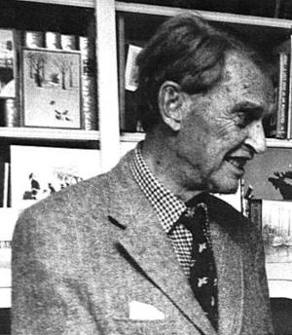
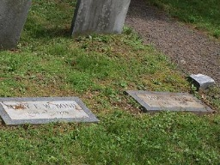
James Bond The Ornithologist
Born in 1900 at the Willowbrook estate, now Gwynead Mercy College
Educated in England
Returned to US in early 1920’s
Joined the Academy Of Natural Sciences in the study of Ornithology
Discovered Bond (or Jamaica) Line
Wrote Birds Of the West Indies in 1936 (reissued in 1948 and 1960)
Married in 1953
Supposedly was name used by Ian Fleming for his hero in Casino Royale
Subject of the book “The Private Life Of James Bond” in the 1980’s
Died in 1989

